Slide 1
Analyzing Health Equity Using Household Survey Data
Lecture 5
Health Outcome #3: Adult Health
Notes:
Child mortality and nutrition status, considered in lectures 3 and 4, respectively, are important indicators of population health. But they provide only a partial picture of the level and distribution of health in a population. Survival is a rather crude indicator of health that ignores all aspects of health-related quality of life. Anthropometrics do indicate quality of life but only in a very partial manner. They are not sensitive to many health problems and are of relatively limited use as indicators of adult health status. To examine inequalities in general health in a population, a measure of health is required that is sensitive to a wide range of health problems and is informative about the health of adults. The literature on health status or health-related quality of life measurement is vast (see, e.g., Patrick and Chiang [2000]). In this lecture, we restrict attention to the measurement of self-reported adult health in the context of general population health inequalities.
Indicators deriving from three models of health – medical, functional and subjective - are considered for the measurement of socioeconomic related health inequalities.
All the indicators considered rely on self-reports in surveys. We consider the extent to which the measurement of health inequality is biased by socioeconomic differences in the reporting of health.
One may wish to examine the distribution of health in relation to SES conditional on third factors, such as age and sex, which are correlated with both health and SES. The lecture demonstrate how to standardize health distributions for differences in demographic composition of SES groups and so provide a more refined description of socioeconomic inequality in health.

Slide 2
Multidimensionality of health
taken account of in generic health profiles that score dimensions using social preferences:
  SF-36 (Ware et al, 1992; Brazier et al, 1998)
  Euroquol-5D ((Busschbach et al. 1999)
  McMaster Health Utility Index (HUI) (Feeny et al. 2002)
But usually only available in health surveys with limited socioeconomic data to measure socioeconomic health inequalities.
For health equity analysis, usually restricted to a summary indicator of general health
Notes:
A generic health profile is derived by asking individuals to rate their health within a number of dimensions, e.g. mobility, sight, emotional, etc. Scores on this different dimensions are aggregated into a single index using weights that are derived from social preference data. The latter are collected by asking a sample of the public to make trade-offs between health scenarios that differ with respect to different dimensions. Standard gamble or time trade-off methods may be used in this exercise.
Ware JJ, Sherbourne CD. The MOS 36-item short-form health survey (SF-36). I. Conceptual framework and item selection. Medical Care 1992; 30:473-83

Slide 3
Three models of general health
Medical: Health defined in terms of deviations from medical norms.
  Presence of (diagnosed) diseases, conditions, handicaps
Functional: Ability to perform “normal” tasks/roles.
  Impaired Activities of Daily Living (ADL), # days of restricted activity
Subjective: Individual’s perception of health, or changes therein, possibly relative to others of same age.
  Self Assessed Health (SAH): “How do you rate your health in general—excellent, good, fair, or poor?”
  High predictive power for mortality and medical care utilisation
Notes:
This lecture illustrates the use of the three different types of adult health indicators—medical, functional, and subjective—to describe the distribution of health in relation to socioeconomic status (SES).

Slide 4
Indicators of Adult Health by Household Expenditure Quintile, Jamaica 1989
 |  |  | Quintiles
 |  | Mean | Poorest | 2 | 3 | 4 | Richest
Medical model: 4 week illness
Illness or injury? |  | 0,144 | 0,163 | 0,135 | 0,141 | 0,143 | 0,140
Nr of illness days |  | 1,675 | 2,279 | 1,643 | 1,715 | 1,550 | 1,218
Acute illness (<4w) |  | 0,088 | 0,080 | 0,085 | 0,087 | 0,094 | 0,093
Chronic illness (>4w) |  | 0,055 | 0,083 | 0,049 | 0,055 | 0,047 | 0,044
Functional model: activity limitations
Major Limitation |  | 0,147 | 0,203 | 0,169 | 0,153 | 0,101 | 0,115
Minor Limitation |  | 0,260 | 0,334 | 0,314 | 0,255 | 0,199 | 0,205
Nr of restricted-activ days |  | 0,825 | 1,307 | 0,818 | 0,807 | 0,752 | 0,461
ADL Index |  | 0,898 | 0,852 | 0,885 | 0,899 | 0,930 | 0,924
Subjective model: self-perceived
Less-than-good SAH |  | 0,170 | 0,238 | 0,193 | 0,169 | 0,134 | 0,120
Poor SAH |  | 0,058 | 0,097 | 0,066 | 0,061 | 0,035 | 0,034
Notes:
The table shows the distributions of mean adult health across quintiles of equivalent expenditure in Jamaica derived from the 1989 Survey of Living Conditions (SLC) for 10 different indicators.
All of the medical model indicators are dichotomous except the number of illness days.
Two of the functional model indicators are dichotomous, the third is a count (number of restricted-activity days), and the fourth is the ADL index transformed to a (0,1) scale using a scoring algorithm developed by the RAND-MOS researchers (Hays et al. 1998). It is defined simply as the sum of all activities scored as 0 if “unable to do,” 50 if “able with difficulty,” and 100 if “able without any difficulty.” This sum ranges between 0 and k*100, where k is the number of activities, but can be rescaled to (0,1) using ADL index = (max-sum)/(max-min), where max and min are the sample maximum and minimum sums, respectively.
The subjective indicator is SAH with five response categories. From that, two dichotomous indicators of less than good health and poor health are created.
All indicators but for acute illness show health to be lower among poorer quintiles, but relative differences in health between the richest and poorest quintiles vary across the indicators. ADL has the smallest gradient. Gradient in SAH larger than in the medical model indicators. Might reflect differential utilisation of medical care.

Slide 5
Heterogeneous health reporting
Analyses of socioeconomic differences in adult health rely on self-reported indicators
Differential reporting of health by socioeconomic status (SES) would bias estimation of the gradient
For example, in developing countries, gradient in reported health (e.g. LSMS illness) often much smaller than that in mortality/anthropometrics
At same true but unobserved health, poor report better health?
Thresholds for reporting poor health may vary by SES or its correlates
Notes:
There are, of course, many analyses of socioeconomic differences in mortality but here we are concerned with analyses based on survey data.
See the previous table. There is a pro-poor gradient in reported acute illness. It is quite common to find this, or the absence of any gradient, in developing countries.

Slide 6
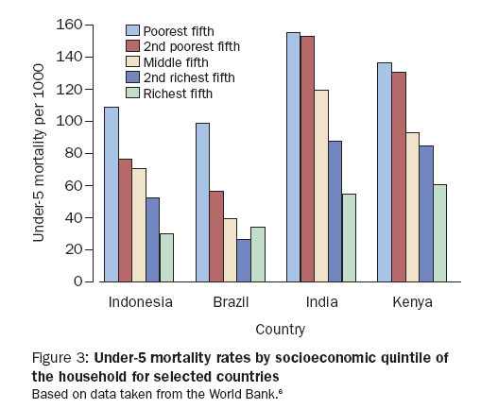
Notes:
1. This slide is to support the third point on the previous slide. See here very steep gradients in child mortality. Reported indicators of adult health, particularly the LSMS question about illness in the last 4 weeks, do not reveal such gradients.

Slide 7
Response Category Cut-point Shift
Very good
Good
Moderate
Bad
Very bad
True Health
Response Scale
A B C
Notes:
Consider responses to the 5-category SAH instrument. Assume that there is a concept of “true” health status for each individual, which is unobserved. It is represented on a vertical axis with higher points, represented by the red lines, indicating better health.
The ranges of true health within which different responses are given to the SAH question vary across individuals (A, B & C).
Relative to A, B is more positive and C more negative regarding their health.
At the top level of “true” health (top red line) A reports good health, B very good and C moderate.
At the middle level of true health, A reports moderate health, B god and C bad.
At the lowest level of true health, A reports bad health, B moderate and C very bad.
Variations such as these can be expected across individuals. If the variation is random, it will not bias the measurement of socioeconomic-related health inequality. But if there is systematic variation in relation to SES or its correlates, then it would bias the estimation.

Slide 8
Is there evidence of reporting differences by SES?
High-income countries
  Mixed evidence on variation in ability of SAH to predict mortality by socio-demographics
  Variation in SAH by SES after controlling for objective measures of health?
    Not for Canada (Lindeboom & van Doorslaer, 2004)
    Some for France (Etile & Milcent, 2006)
Developing countries
  Prima facie evidence from inconsistency between steep gradients in mortality/anthropometrics and smaller or no gradients in reported health
Notes:
1. Idea of the first test is that reported bad health should better predict mortality among the poor if they are less likely to report bad health, since then it represents a lower true state of health.
2. Evidence of no differences in SAH-mortality correlation by SES:
a) Burstrom B, Fredlund P. Self rated health: is it as good a predictor of subsequent mortality among adults in lower as well as in higher social classes? J Epidemiol Community Health 2001; 55:836–40.
b) Van Doorslaer E, Gerdtham UG. Does inequality in self-assessed health predict inequality in survival by income? Evidence from Swedish data. Social Science & Medicine 2003; 57: 1621-1629
3. Evidence of stronger SAH-mortality correlation at higher SES:
a) Beam Dowd J, Zajacova A. Does the predictive power of self-rated health for subsequent mortality risk vary by socioeconomic status in the US? Int J Epidemiol 2007; 36:1214–21.
b) Huisman M, van Lenthe F, Mackenbach J. The predictive ability of self-assessed health for mortality in different educational groups. Int J Epidemiol 2007; 36:1207–13.
4. Evidence of weaker SAH-mortality correlation at higher SES:
a) Jurges H. Self-assessed health, reference levels and mortality. Applied Economics (in press).
b) Singh-Manoux A, Dugravot A, Shipley MJ, et al. The association between self-related health and mortality in different educational groups. Int J Epidemiol 2007; 36:1222–28.
5. Lindeboom M, van Doorslaer E. Cut-point shift and index shift in self-reported health. J Health Econ 2004; 23: 1083-1099.
6. Etilé F, Milcent C. Income-related reporting heterogeneity in self-assessed health: evidence from France. Health Economics 2006; 15: 965-81.

Slide 9
Correcting reporting bias using vignettes
King et al (2004) proposed identification and correction of reporting heterogeneity using evaluation of health vignettes
Vignettes describe a given health state
Assuming all respondents recognise the vignette as representing the same dimension of health, variation in its evaluation derives only from reporting differences
Assuming respondents rate their own health in the same way as the vignette, the common cut-points estimated from the vignette responses can be imposed on the evaluation of own health
Using the corrected cut-points, variation in reported own health is purged of systematic reporting heterogeneity and reflects true health variation
Implemented by the hierarchical ordered probit model (HOPIT)
Notes:
King G, Murray CJL, Salomon J, Tandon A. Enhancing the validity and cross-cultural comparability of measurement in survey research. American Political Science Review 2004; 98: 184-91.
The first assumption is referred to as vignette equivalence.
The second assumption is referred to as response consistency.

Slide 10
Example: Mobility vignettes
[Mary] has no problems with walking, running or using her hands, arms and legs. She jogs 4 kilometres twice a week.
[Anton] does not exercise. He cannot climb stairs or do other physical activities because he is obese. He is able to carry the groceries and do some light household work.
[David] is paralyzed from the neck down. He is unable to move his arms and legs or to shift body position. He is confined to bed.
[Rob] is able to walk distances of up to 200 metres without any problems but feels tired after walking one kilometre or climbing up more than one flight of stairs. He has no problems with day - to - day physical activities, such as carrying food from the market.
[Vincent] has a lot of swelling in his legs due to his health condition. He has to make an effort to walk around his home as his legs feel heavy.
Notes:
1. The other dimensions that have been used include pain, emotional behavior, sleep, cognition, self-care, usual activities, breathing.

Slide 11
Reporting heterogeneity in China, India and Indonesia (Bago d’Uva et al, 2008)
WHO Multi-Country Survey Data-Indonesia, Andrah Pradesh & 3 Chinese provinces
Ratings for 6 health domains
Are poor more likely to report same condition as very good?
  Yes in India & China, not in Indonesia
Does reporting hetero. bias the SES-health gradients?
  Yes, for some domains, and some countries. Not for others.
Notes:
1. Bago d'Uva T, van Doorslaer E, Lindeboom M, O'Donnell O. Does reporting heterogeneity bias the measurement of health disparities? Health Economics (in press).

Slide 12
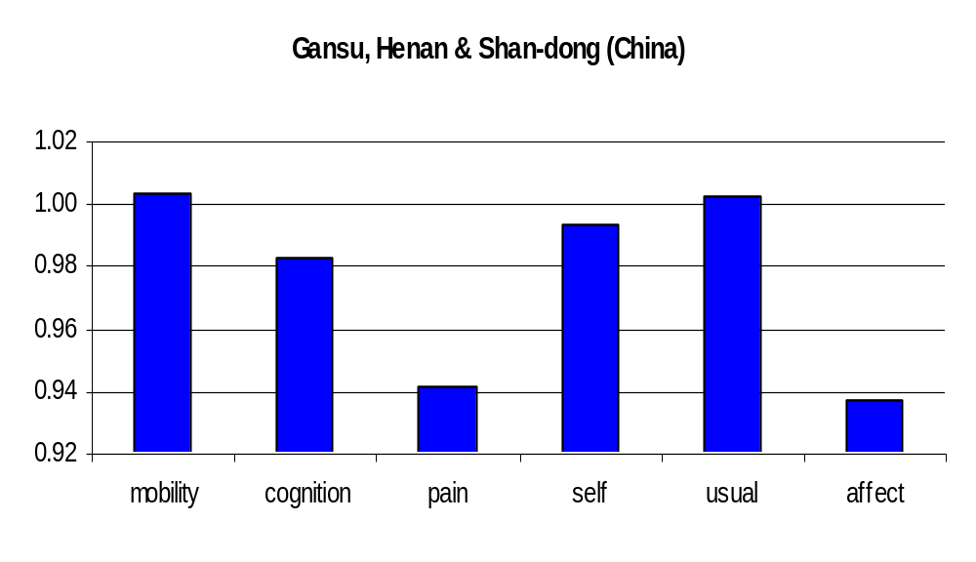
Rich have higher health expectations in China
Ratio of top to bottom income quintile of probability of reporting given vignette as very good health

Slide 13
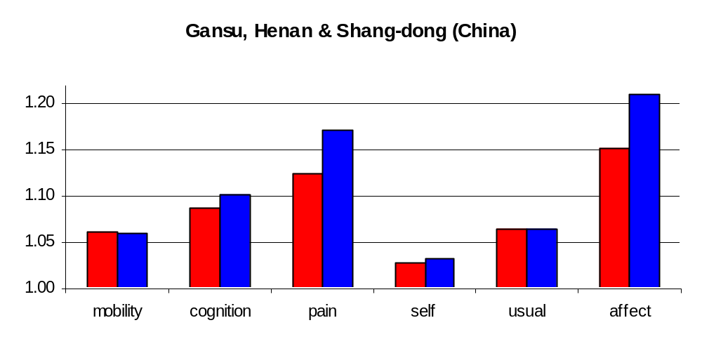
Correcting reporting differences increases the SES gradient in health in China
Ratio of top to bottom quintile of probability of being in very good health (own)
Notes:
1. Red is before correction. Blue after correction.

Slide 14
Correcting for reporting hetero increases measured disparities in health by education in Europe (Bago d’Uva et al, 2008b)
Country | Pain | Sleep | Mobility | Emotional | Cognition | Breathing
Belgium | ▲ | ▲ | ▲ | ▲ | ▲ | ▲
France | ▲ | ▲ | ▲ | ▲ | ▲ | ▲
Germany | ▲ | ▲ | ▲ | ▲ | ▲ | ▲
Greece | ▲ | ▲ | ▲ | ▲ | ▲ | ▼
Italy | ▲ | ▲ | ▲ | ▲ | ▼ | ▲
Netherlands | ▲ | ▲ | ▲ | ▲ | ▲ | ▲
Spain | ▼ | ▲ | ▲ | ▼ | ▼ | ▲
Sweden | ▲ | ▼ | ▼ | ▼ | ▼ | ▲
Notes:
Bago d’Uva, T., O’Donnell, O., van Doorslaer, E. Differential health reporting by education level and its impact on the measurement of health inequalities among older Europeans, Netspar Discussion Paper..
Again using the vignettes (HOPIT) methodology.
Data are from SHARE, which covers the population aged 50 and above.
Large ▲ – High to low education rate ratio is insignificant (5%) before correction and becomes significantly greater than 1 after adjustment.
Small ▲ – Rate ratio increases with the correction, but significance does not change (ie, either adjusted and unadjusted are significant, or both are insignificant).
Small ▼ – Rate ratio decreases with adjustment but significance does not change.
Large ▼– Rate ratio is significant before adjustment and becomes insignificant with the adjustment.

Slide 15
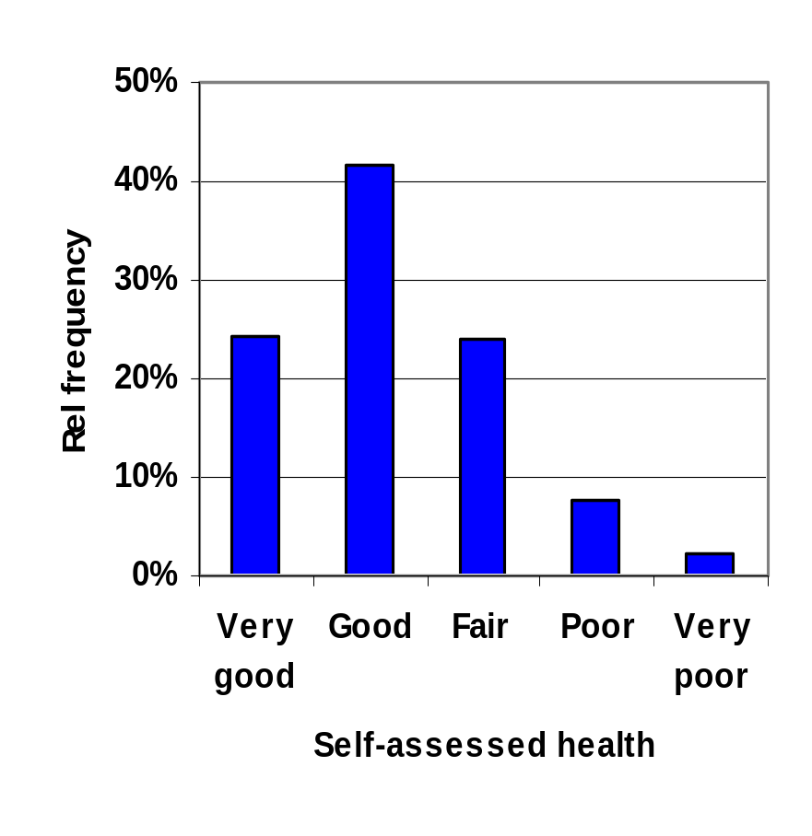
Describing health inequalities with categorical data
SAH only provides ordinal information
How to use this?
  Dichotomization is arbitrary and measured inequalities may vary with the dichotomy chosen
Simple scoring (1-5) implies difference in health b/w successive categories is constant!
Notes:
Data for the graph are from the European Community Household Panel (all countries pooled).
Dichotomization of the multiple-category responses gives a measure of health as the percentage of individuals with that characteristic, that is, those who report their health to be “less than good.” This practice avoids the imposition of some scale that is assumed to indicate how much more health is enjoyed in one category compared with another for any one individual. But it obviously results in a loss of information and requires the introduction of an arbitrary cutoff point (Wagstaff and van Doorslaer 1994). If the threshold at which “less than good health” is reported varies across cultures and/or population subgroups, then the dichotomous indicator will not indicate variation in prevalence of a given level of health across countries and/or socioeconomic groups (c.f. Salomon et al 2004).
Allison and Foster (2004) introduce a method of obtaining a partial inequality ordering of SAH distributions that is invariant to the scaling of SAH. This is a significant advance in the literature, but it does have two limitations. First, the inequality of two SAH distributions can be compared only when their median categories coincide. Second, the method allows comparison of total inequality in SAH and not in socioeconomic-related inequality in SAH.

Slide 16
Transforming SAH to a cardinal scale
  One approach is to impose the SAH category specific mean (median) value of some generic health index (e.g. SF-36, HUI) on all observations reporting that category
  Requires a dataset with both SAH and the generic index
  Assumes distribution of the generic index across SAH categories is the same in the current data as the original data from which mean values are taken

Slide 17
Regression approaches to transforming SAH to a cardinal scale
Regression can be used to increase variation
  But the results become dependent on the covariates used in the regression
Regress SAH on covariates using ordered probit/logit and use the predictions scaled to 0-1 using (max-prediction)/(max-min)
  Must assume distribution for errors of latent health
Interval regression used if the SAH category bounds are imposed from dataset with both SAH and a generic index
  Then predictions are on the scale of the generic index

Slide 18
Van Doorslaer & Jones (2003) transform SAH to HUI scores
They use data from 1994 Canadian NPHS
They find the interval regression approach has higher internal validity in the Canadian data

Slide 19
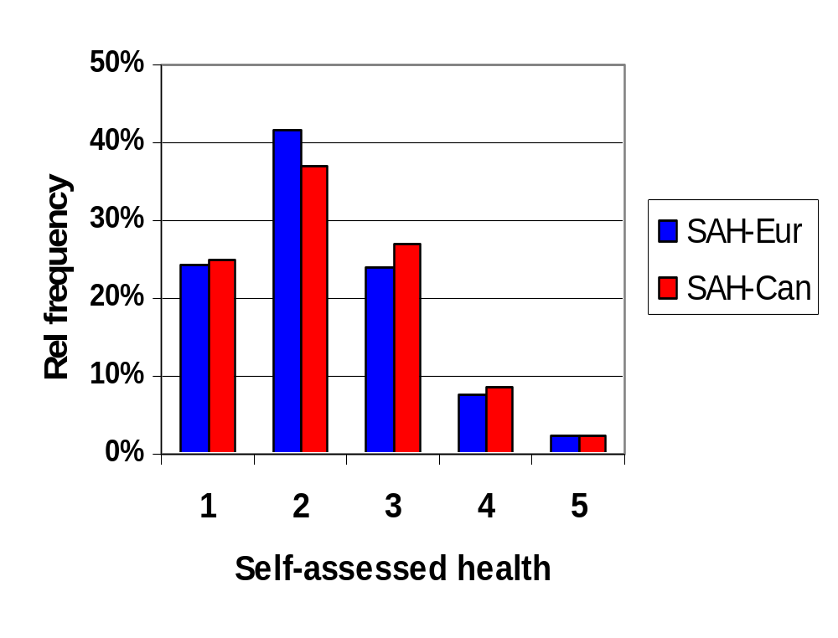
SAH frequency distributions
Europe ECHP ‘95: VG-VP, Canada NPHS 94: EVGFP
Notes:
The ECHP responses are very good, good, fair, poor, very poor
The NPHS responses are excellent, very good, good, fair, poor.
We see that although the category labels differ, the distributions are very similar.
This suggests that it may be acceptable to impose the Canadian HUI scores for the bounds on the European SAH data.

Slide 20
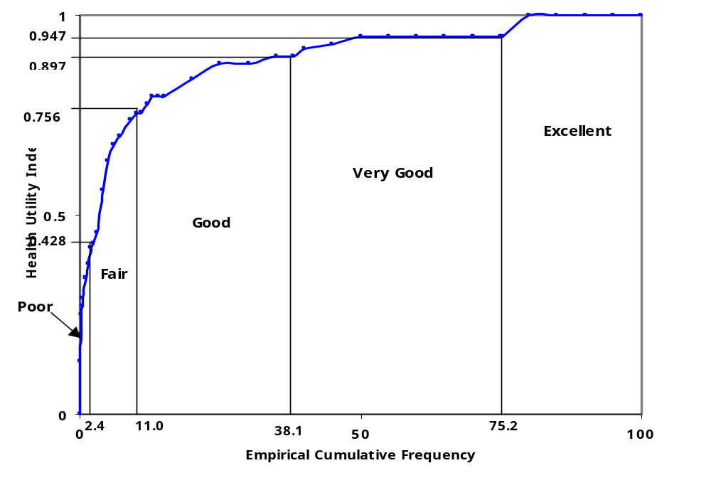
Empirical distribution of HUI and derived SAH category bounds (Canada, 1994)
Notes:
1. The blue line traces the empirical cumulative distribution of HUI. The percentage of the sample in each of the SAH categories is show on the horizontal. For example, 24.8% (100-75.2) report excellent health. This corresponds to all those with a HUI score greater than 0.947. The 2.4% declaring poor health correspond to those with a HUI score less than 0.428.

Slide 21
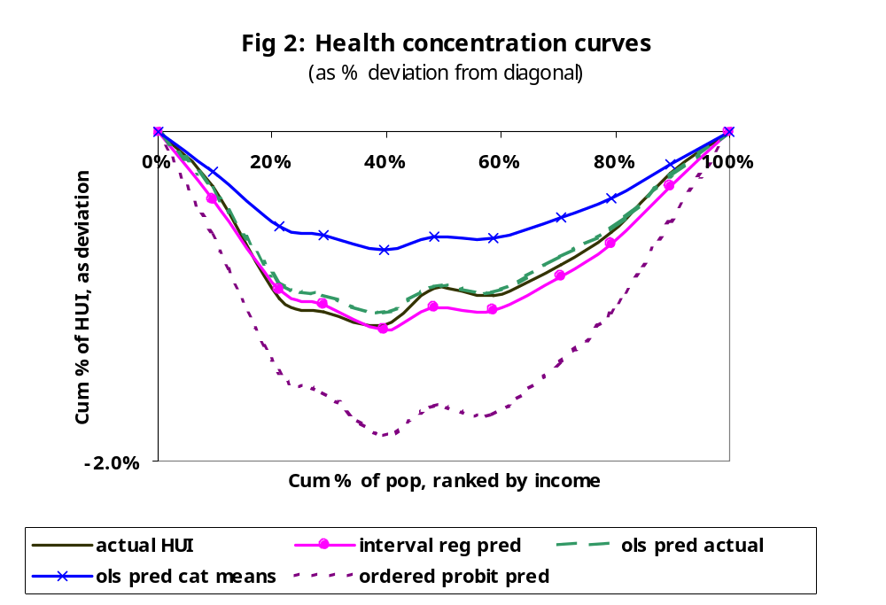
Interval regression gives the best approximation to the distribution
Notes:
Data are from the 1994 Canada NPHS.
The aim here is to describe the distribution of health in relation to income. A concentration curve is used to do this. This will be discussed in lecture 7. Each line shows an estimate of the extent to which moving up the sample ranked by income (from poorest to richest) the cumulative percentage of health deviates from the population proportion. If there were no inequality, the line would lie on the horizontal. The fact that all lines lie below the horizontal indicates health inequality to the disadvantage of the poor.
The solid black line is the distribution derived from the individual specific actual HUI scores. This is the benchmark.
The green dashed line is derived from OLS predictions using actual HUI scores as the dependent variable. Since all approximation methods are derived from regression predictions, this is the appropriate point of comparison to assess those approximations.
The pink line is derived from the interval regression predictions, using the HUI scores for the bounds of the SAH categories. This provides the best approximation to the distribution amongst the methods that rely on the transformed SAH variable, and not the actual HUI scores.
OLS predictions using the SAH category means of HUI (and not the boundary values) (blue line) substantially underestimates the income-related health inequality.
Predictions from the ordered probit, which does not use the HUI scores at all, substantially overstates the degree of inequality.

Slide 22
Demographic standardization
Want to examine socioeconomic-related inequality in health conditional on age/sex
Standardization necessary in case that age/sex correlated with both health and SES
Direct standardization → distribution if all SES groups had same age/sex structure
Indirect standardization → corrects distrbn by comparing with that expected given actual age/sex
Direct standardization requires grouping
Both methods can be implemented by regression
Can include other variables in the regression analysis to reduce bias in the estimated effects of the confounding variables (age/sex) on health
Notes:
Direct standardization provides the distribution of health across SES groups that would be observed if all groups had the same age structure, for example, but had group-specific intercepts and age effects.
Indirect standardization, however, “corrects” the actual distribution by comparing it with the distribution that would be observed if all individuals had their own age but the same mean age effect as the entire population.
Last point: For example, take the case in which age is correlated with education and both are correlated with both health and income. If one includes only age in a health regression, then the estimated coefficient on age will reflect the joint correlations with education and, inadvertently, one would be standardizing for education, in addition to age, differences by income. One may avoid this, if so desired, by estimating the age correlation conditional on education.

Slide 23
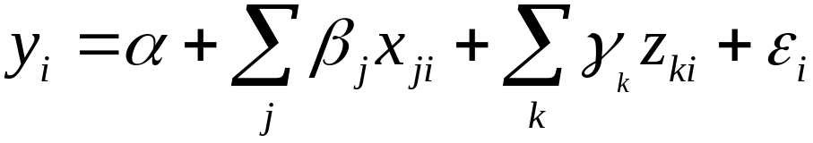
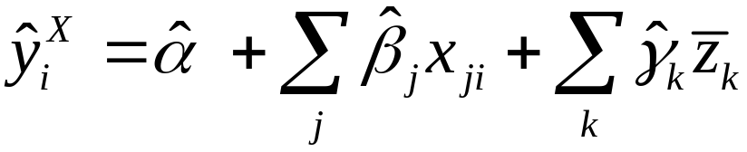



Indirect standardization
y_{i} – health, x_{ji} – age/sex,
z_{ki} – control vbl. e.g. education
Predicted values from:
are OLS estimates
are sample means
Standardized health:
Sample mean is added to ensure
standardized = actual mean
Notes:
The xj are confounding variables for which we want to standardize (e.g., age and sex), and the zk are nonconfounding variables for which we do not want to standardize but to control for in order to estimate partial correlations with the confounding variables. In the instance that we want to standardize for the full correlations with the confounding variables, the zk variables are left out of the regression.
The distribution of standardized health (e.g., across income) can be interpreted as the distribution of health that would be expected to be observed, irrespective of differences in the distribution of the x’s across income.

Slide 24
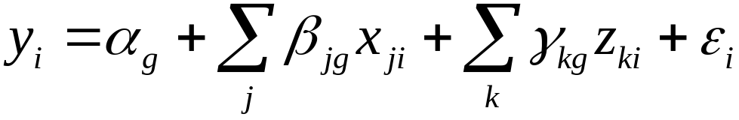

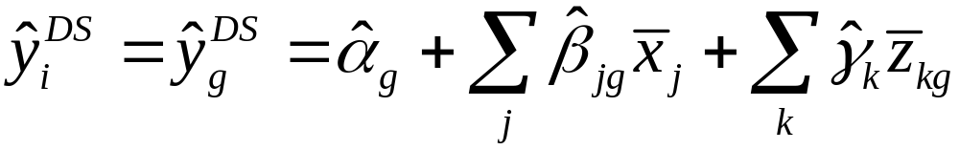

Direct standardization
Group (g) specific regression:
Standardized health:
sample means
group-specific
means
Immediately gives standardized distribution of health
across (e.g., income) groups
Notes:
For grouped data, both the direct and indirect methods answer the question, “What would the health distribution across groups be if there were no correlation between health and demographics?” But their means of controlling for this correlation is different. The direct method uses the demographic distribution of the population as a whole, but the behavior of the groups. The indirect method employs the group-specific demographic characteristics, but the population wide demographic effects.
The advantage of the indirect method, however, is that it does not require any grouping and is equally feasible at the individual level. The results of the two methods will differ to the extent that there is heterogeneity in the coefficients of x variables across groups because the indirect methods impose homogeneity and the difference will depend on the grouping used in the direct method.

Slide 25
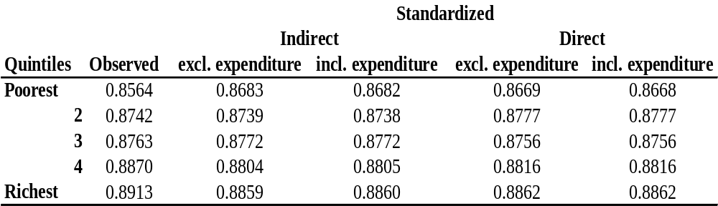
Direct and Indirect Standardized Distributions of SAH, Jamaica 1989
Household Expenditure Quintile Means
of SAH Index (HUI)
Notes:
The health measure is SAH scaled using the Canadian SAH category-specific means of HUI as described above.
Standardisation is for age and sex
Standardisation is conducted by both methods and, in each case, without and with control for household expenditure in estimation of the age/sex effects. That is without and with household expenditure as a z variable.
The four standardized distributions are very similar in this example, suggesting that there is little heterogeneity in the age-sex effects across quintiles and that omitting expenditure from the SAH regressions does not bias these effects. However, standardization, by whichever method, does reduce the measured rich-poor disparities in SAH.

